Slide 1

UCITS01 – Assets must be Eligible Asset Types

Slide 2
What does the rule monitor?
  UCITS01 monitors COLL 5.2.6 R and evaluates the asset types within a scheme and flags a breach if ineligible asset types are identified.

Slide 3
What fields does this rule monitor?
  This rule looks primarily at the “Asset Type Name” field of every security.
What asset type groups does it monitor?
  This rule is applied to Properties, Precious Metals, Commodities and unclassified assets.
Why might this rule be flagging as a breach?
  This breach could be occurring as the result of misclassification of asset type.

Slide 4
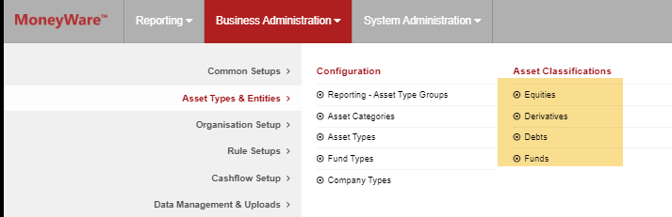
How can I clear this breach?
  Find the instrument in the relevant Asset Classification Master on FundWare.
  Review whether the Asset Type Name is correct for that instrument.
  If it is not correct and the appropriate asset type belongs to the same asset classification group, then you can update this.
  If the appropriate asset type belongs to a different asset classification, then the security will need to be made inactive in the master it currently resides in before it can be re-setup in the correct master.

Slide 5
How can I view this in a report?
  On FundWare, you can go to Reporting -> Holding Reports - > Holding Report and select one of a wide range of reports (e.g. Holding Export Report) to extract.

Slide 6


