Slide 1

UCITS02 – Eligible Transferable Securities

Slide 2
What does the rule monitor?
  UCITS02 monitors COLL 5.2.7 R at instrument level and classifies securities as transferable or not based upon a Rule Custom Attribute that has been created on FundWare. The breach will flag where the instrument is considered not to be transferable.

Slide 3
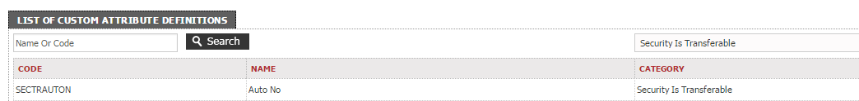
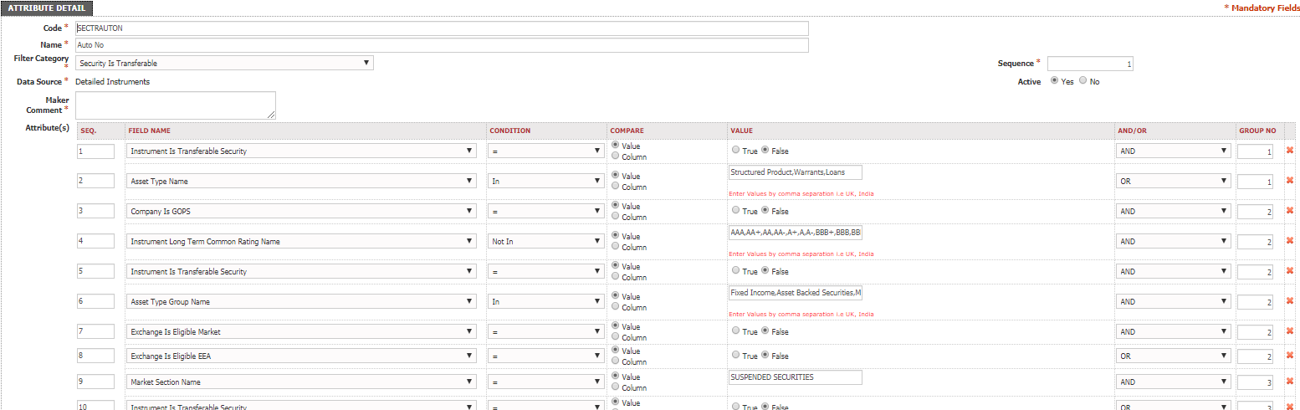
What fields does this rule monitor?
  This rule uses the ‘Security is Transferable’ rule custom attribute to determine eligibility. This RCA is customised to identify those securities that may be non-transferable. One such example is that if the market section value appears as “suspended security” then the security determined not to be eligible.

Slide 4
What asset type groups does it monitor?
  This rule is applied to equities, debentures, government and public securities, warrants and certificates representing certain securities.
Why might this rule be flagging as a breach?
  It’s possible the exchange isn’t populated for an instrument. Many of the RCA conditions rely on the exchange field and if it is not populated then it could be falsely appearing as non-transferable.
  The exchange the instrument is listed on could be a non-EEA eligible market and as such may require a further system change to clear.

Slide 5
How can I clear this breach?
  If it the exchange is not populated then you go to the relevant instrument master (e.g. Equity, Debt) and locate the security. Go to the ‘Exchanges’ section of the page and find the correct exchange for the instrument. Add the SEDOL into the “Symbol Code” box and select the relevant Market Section from the drop-down menu.
  Alternatively, you can override the RCA result by finding the security in the relevant instrument master and setting the “Security Transferable” field to be TRUE.

Slide 6
How can I view this in a report?
  On FundWare, you can go to Reporting -> Holding Reports - > Holding Report and select one of a wide range of reports (e.g. Holding Export Report) to extract.
  You may wish to include columns called “Instrument Exchange Short Name” and “Rule Custom Attribute.Security Is Transferable” to evaluate the current exchange and RCA values.

Slide 7


