Slide 1

UCITS03 – CIS must be UCITS or equivalent Non-UCITS CIS

Slide 2
What does the rule monitor?
  UCITS03 monitors COLL 5.2.13 R and COLL 5.2.14 R at instrument level and evaluates whether a collective investment scheme (CIS) is a UCITS or is an equivalent non-UCITS CIS.

Slide 3
What fields does this rule monitor?
  This rule looks primarily at 3 fields that can be found in the Fund Master on FundWare for an individual fund:
  Structure
  UCITS Equivalent
  CIS Type
  The rule will only monitor those funds with a structure that is Open Ended.
  Additionally, if the UCITS Equivalent field is marked as ‘No’ and the CIS Type is one of the following then it will flag as a breach:
  NON_UCITS
  OTHER
  UK Investment Trust
  UK_NURS
  UK_QIS
  UNKNOWN

Slide 4
What asset type groups does it monitor?
  This rule is applied to open ended funds.
Why might this rule be flagging as a breach?
  This breach will appear any time a UCITS fund invests into an open-ended fund that has been newly setup on FundWare.
  Security data provided by the data vendor does not specify the information we need to clear the breach. As a result of this, the system will automatically default the new funds as NON_UCITS. This serves as a prompt for the research to be completed.

Slide 5
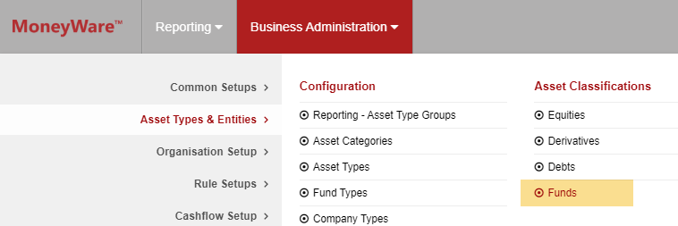
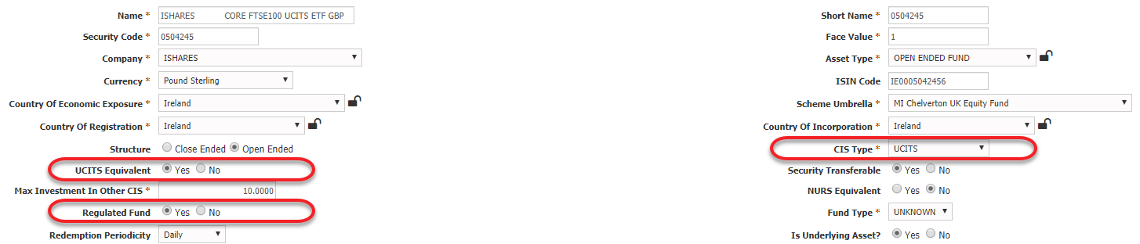
How can I clear this breach?
  If the fund is a UCITS then you will need to update the
  following fields in the Fund Master for this security:
  CIS Type = UCITS
  UCITS Equivalent = Yes
  Regulated Fund = Yes
  If the fund is not a UCITS but is an equivalent then you can also update the fields as above and set the CIS Type to a more suitable option.
  Once the changes have been saved, they will need to be approved by another system user for the changes to go live.

Slide 6
How can I view this in a report?
  On FundWare, you can go to Reporting -> Holding Reports - > Holding Report and select one of a wide range of reports (e.g. Holding Export Report) to extract.
  You may wish to include the following columns:
  Rule Custom Attribute.Fund Structure
  Rule Custom Attribute.CIS Type
  Instrument is UCITS Equivalent

Slide 7


