Slide 1

UCITS04 – CIS must invest max 10% in other CIS

Slide 2
What does the rule monitor?
  UCITS04 monitors COLL 5.2.13 R (3) at instrument level and evaluates the investment of CIS held by any schemes into other funds, with a maximum limit of 10% of the second scheme’s NAV invested into other CIS.

Slide 3
What fields does this rule monitor?
  This rule looks primarily at 2 fields that can be found in the Fund Master on FundWare for an individual fund:
  Structure
  Max Investment In Other CIS
  The rule will only monitor those funds with a structure that is Open Ended and have a ‘Max Investment In Other CIS’ value that is greater than 10%.
What asset type groups does it monitor?
  This rule is applied to open ended funds.

Slide 4
Why might this rule be flagging as a breach?
  This breach will appear any time a UCITS fund invests into an open-ended fund that has been newly setup on FundWare.
  Security data provided by the data vendor does not specify the information we need to clear the breach. As a result of this, the system will automatically default the maximum investment in other CIS to be 100%.
  This serves as a prompt to go and research this information.

Slide 5
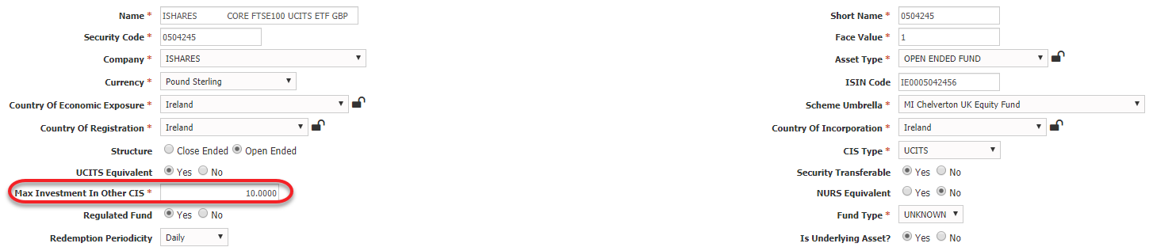
How can I clear this breach?
  Find the security in the Fund Master on FundWare and update the field called “Max Investment In Other CIS” to be the correct figure as stipulated by the fund’s prospectus.
  A value of 10 or below will clear the breach. Do not include the “%” symbol in the text field box. It just requires the figure.
  Once the changes have been saved, they will need to be approved by another system user before the changes can go live.

Slide 6
How can I view this in a report?
  On FundWare, you can go to Reporting -> Holding Reports - > Holding Report and select one of a wide range of reports (e.g. Holding Export Report) to extract.
  You may wish to include the following columns:
  Rule Custom Attribute.Fund Structure
  Max Investment In Other CIS

Slide 7


