Slide 1

UCITS05 – Deposits must have a maturity of less than 12 months

Slide 2
What does the rule monitor?
  UCITS05 monitors COLL 5.2.26 R (3) and evaluates the maturity of cash and deposits instruments. It breaches if the maturity is more than 365 days.

Slide 3
What fields does this rule monitor?
  This rule looks primarily at 2 fields that can be found in the Debt Master on FundWare:
  Maturity Date
  Repayable on Demand
What asset type groups does it monitor?
  This rule is applied to deposits.
Why might this rule be flagging as a breach?
  This breach could be occurring as the result of an absent or incorrect maturity date.
  Additionally, if the deposit is repayable on demand but not reflected as this on the system then it could cause a breach to flag.

Slide 4
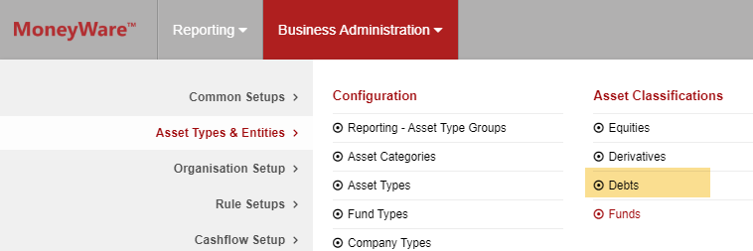
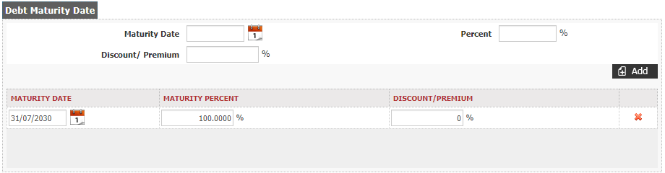
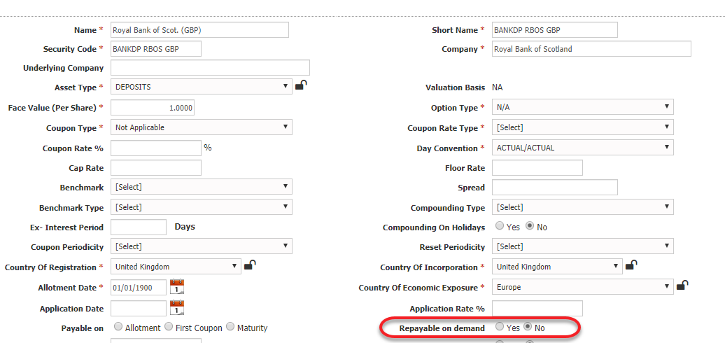
How can I clear this breach?
  Find the security in the Debt Master on FundWare.
  Amend the Maturity Date using the calendar icon if the date appearing is not correct.
  If the Maturity Date is correct but the deposit is repayable on demand then the “Repayable on Demand” field can be updated to be ‘Yes’.

Slide 5
How can I view this in a report?
  On FundWare, you can go to Reporting -> Holding Reports - > Holding Report and select one of a wide range of reports (e.g. Holding Export Report) to extract.
  You may wish to include the following columns:
  Rule Custom Attribute.Repayable On Demand
  Days to Maturity

Slide 6


