Slide 1

UCITS06 – Deposits must be made with acceptable credit institutions

Slide 2
What does the rule monitor?
  UCITS06 monitors COLL 5.2.26 R (1) and evaluates whether deposits have been made with an approved bank.

Slide 3
What fields does this rule monitor?
  This rule looks primarily at the “Acceptable Deposit Taker” field in the Company Master on FundWare.
What asset type groups does it monitor?
  This rule is applied to deposits.
Why might this rule be flagging as a breach?
  This breach could be occurring as the result of an incorrect issuer assigned to a deposit position.
  Alternatively, if the Issuer name is correct, then it may be that it has not been assigned as a deposit taker.

Slide 4
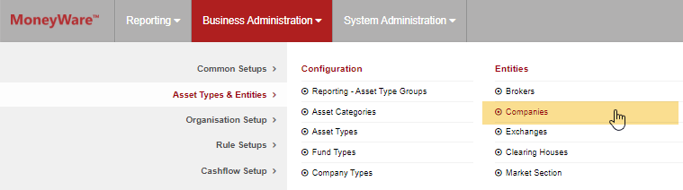
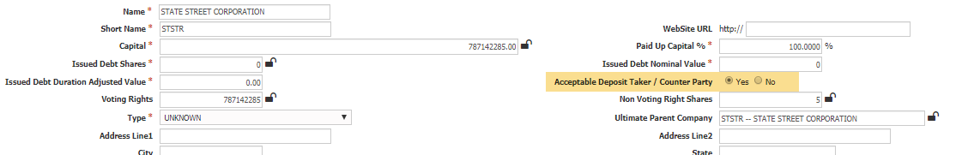
How can I clear this breach?
  Find the issuer in the Company Master on FundWare.
  Amend the “Acceptable Deposit Taker / Counterparty” field to show as ‘Yes’.

Slide 5
How can I view this in a report?
  On FundWare, you can go to Reporting -> Holding Reports - > Holding Report and select one of a wide range of reports (e.g. Holding Export Report) to extract.
  You may wish to include the following columns:
  Issuer is Acceptable Deposit Taker

Slide 6


