Slide 1

UCITS07 – FDI must have Eligible Underlyings

Slide 2
What does the rule monitor?
  UCITS07 monitors COLL 5.2.20 R (2) and evaluates whether the underlying instrument to a derivative is eligible.

Slide 3
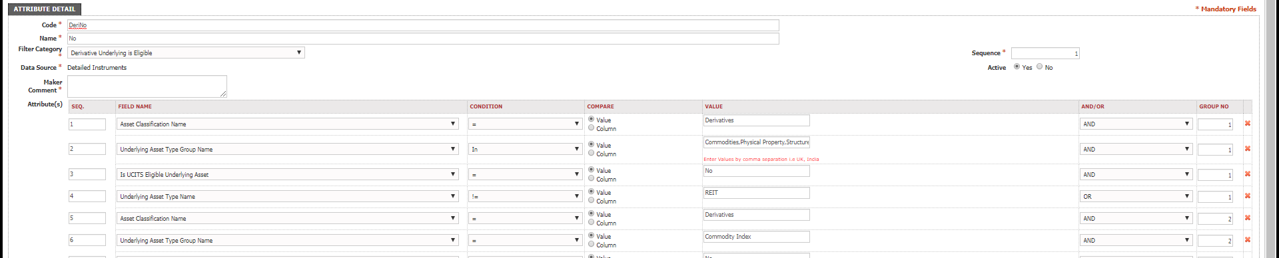
What fields does this rule monitor?
  This rule looks primarily at the “Derivative Underlying is Eligible” rule custom attribute on FundWare.
What asset type groups does it monitor?
  This rule is applied to derivatives (excluding Forward FX and Spots).

Slide 4
Why might this rule be flagging as a breach?
  This breach usually occurs as the result of the underlying being considered as non-eligible by the rule custom attribute.
  It’s possible the underlying has been newly setup/used on the system and thus requires an update to the RCA.

Slide 5
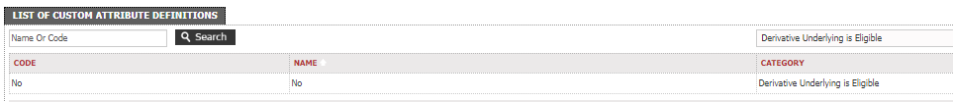
How can I clear this breach?
  First you will need to establish which derivative, and subsequently which underlying instrument, is causing the breach. The breach window will provide information on the specific derivative(s) in question.
  It’s possible the underlying is being picked by the ‘Derivative Underlying is Eligible’ RCA and requires an amendment in order for it not to be considered ineligible.
  Alternatively, you can find the instrument in the relevant instrument master and set the “Is UCITS Eligible Underlying Asset” field to be ‘Yes’ and this override the result.
  Ideally, it’s best to clear the breach using the RCA as you may be able to clear any potential re-occurrences for similar assets.

Slide 6
How can I view this in a report?
  On FundWare, you can go to Reporting -> Holding Reports - > Holding Report and select one of a wide range of reports (e.g. Holding Export Report) to extract.
  You may wish to include the following columns:
  Rule Custom Attribute.Derivative Underlying is Eligible

Slide 7


