Slide 1

UCITS08 – OTC Derivatives must be with Acceptable Counterparties

Slide 2
What does the rule monitor?
  UCITS08 monitors COLL 5.2.23 R (1) and evaluates whether OTC derivatives have an acceptable counterparty assigned to them.

Slide 3
What fields does this rule monitor?
  This rule primarily uses 2 fields:
  ‘Acceptable OTC Limit’ which can be found in the Company Master
  ‘Is OTC’ which is a rule custom attribute.
What asset type groups does it monitor?
  This rule is applied to OTC derivatives.
Why might this rule be flagging as a breach?
  This breach can occur if the counterparty to the OTC derivative is set as ‘Not Eligible’
  It may also occur if the counterparty has not been populated for the instrument.

Slide 4
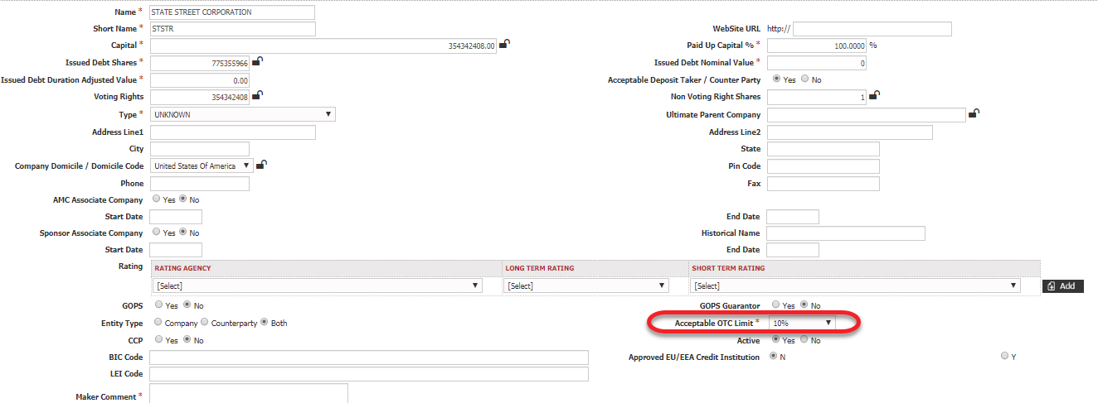
How can I clear this breach?
  If it is due to the counterparty having an OTC Acceptable Limit of ‘Not Eligible’ then you will need to update this in the Company Master.
  UCITS can have a maximum of 5% NAV exposure to any one counterparty through OTC derivatives. This includes any broker margin posted to counterparties. This is increased to 10% NAV for approved credit institutions.

Slide 5
How can I view this in a report?
  On FundWare, you can go to Reporting -> Holding Reports - > Holding Report and select one of a wide range of reports (e.g. Holding Export Report) to extract.
  You may wish to include the following columns:
  Counterparty Acceptable OTC Limit
  Rule Custom Attribute.Is OTC

Slide 6


