Slide 1

UCITS09 – OTC Derivatives must have reliable valuation

Slide 2
What does the rule monitor?
  UCITS09 monitors COLL 5.2.23 R (2) and evaluates whether the underlying to OTC derivatives has a reliable valuation.

Slide 3
What fields does this rule monitor?
  This rule primarily uses 2 fields:
  ‘Derivative has reliable valuation’ which is a rule custom attribute.
  ‘Is OTC’ which is a rule custom attribute.
What asset type groups does it monitor?
  This rule is applied to OTC derivatives.
Why might this rule be flagging as a breach?
  This breach will occur if the underlying instrument for an OTC Derivative is considered to unreliable by the ‘Derivative has reliable valuation’ = No rule custom attribute.

Slide 4
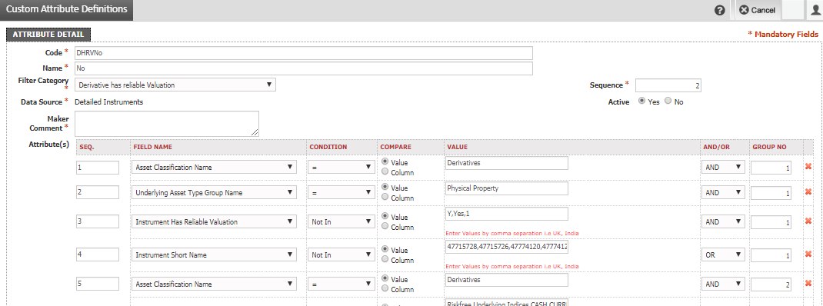
How can I clear this breach?
  Updates can be made to the ‘Derivative has Reliable Valuation’ RCA (DHRVNo) to exclude certain underlying assets as being classified as unreliable.
  Alternatively, if it is an exceptional case then an update can be made in the Derivative Master on FundWare

Slide 5
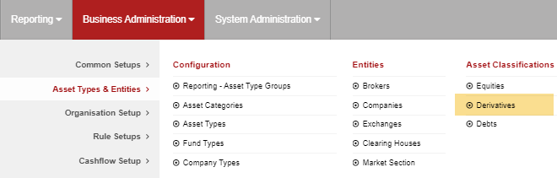
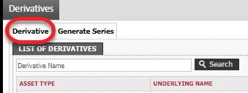
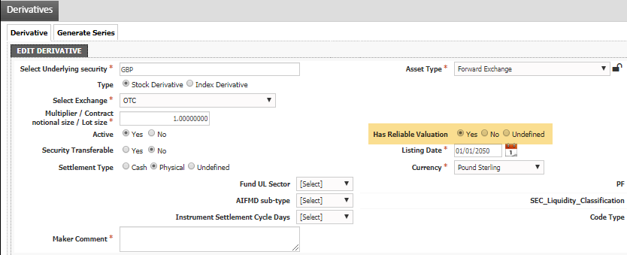
How can I clear this breach? (cont.)
  Alternatively, if it is an exceptional case then an update can be made in the Derivative Master on FundWare.
  You will be able to find the underlying instrument in the ‘Derivative’ tab.
  Once you have found the underlying instrument you can then manually override the result by setting the ‘Has Reliable Valuation’ field to be Yes.

Slide 6
How can I view this in a report?
  On FundWare, you can go to Reporting -> Holding Reports - > Holding Report and select one of a wide range of reports (e.g. Holding Export Report) to extract.
  You may wish to include the following columns:
  Rule Custom Attribute.Derivative has reliable valuation
  Rule Custom Attribute.Is OTC

Slide 7


