Slide 1

UCITS10 – Max. 10% in unapproved securities and MMI

Slide 2
What does the rule monitor?
  UCITS10 monitors COLL 5.2.8 R (4) and monitors the percentage of assets held in unapproved securities and money market instruments.

Slide 3
What fields does this rule monitor?
  This rule primarily uses 2 fields:
  ‘Is Gops’ which is a rule custom attribute. It works in tandem with the field of the same name in the Company Master.
  ‘Scheme Eligible Market Type’ which refers to the list of approved exchanges found in the Scheme Mandate.
  ‘Non EEA Market’ which is a rule custom attribute.
What asset type groups does it monitor?
  This rule is applied to assets that are Equities, Fixed Income and Money Market Instruments.

Slide 4
Why might this rule be flagging as a breach?
  This breach often occurs if the exchange for a security has not been populated or populated correctly. Typically, fixing this issue on the affected securities will resolve the issue.
  However, if the exchanges are correctly populated it may be that Scheme Mandate needs to be updated in order for the rule to know it is an eligible market for this fund.

Slide 5
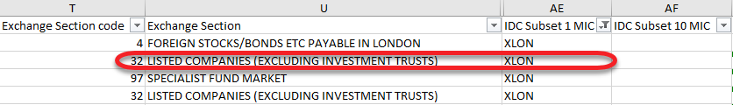
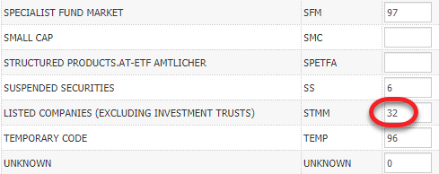
How can I clear this breach?
  If it is a case that exchanges are not populating then this will have to be updated. Ideally, this should be fixed using the Security setup file. Typically, for ICE security data, the “Exchange Section Code” value has to correctly correspond with the Market Section Code for the relevant exchange in the Exchanges Master.
  IDS Security File:
  For the above highlighted security, the exchange will only update if the “LISTED COMPANIES (EXCLUDING INVESTMENT TRUSTS)” market section in the Exchanges master for XLON is populated with the code of 32.
  Exchanges Master:

Slide 6
How can I clear this breach? (cont.)
  Alternatively, if it is an exceptional case then the exchange can be manually updated in the relevant instrument master. Once you’ve identified the security in the instrument master, scroll to the bottom of the page where you will find the ‘Exchanges’ section.
  Location the exchange code for the exchange you wish to update the security to be listed on. The sedol code needs to be added into the “Symbol Code” field and a market section must be selected in the drop-down menu.
  Once the change has been made you will need to add in a comment to the “Maker Comment” field and then send it for approval. The change will only go live once another user has approved it.

Slide 7
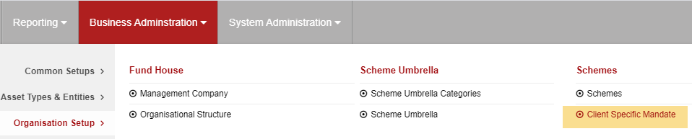
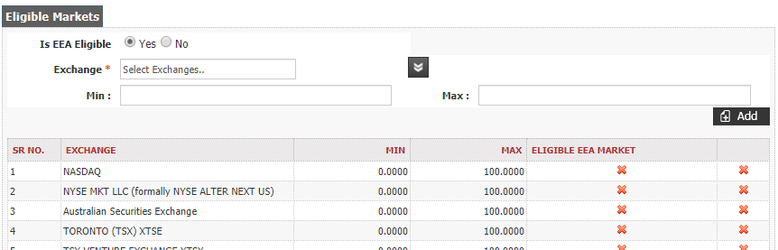
How can I clear this breach? (cont.)
  If the exchanges are correctly populated then it may be a case that the Scheme Mandate for the fund does not have 1 or more of the exchanges listed as eligible.
  Go to Business Administration -> Organisation Setup -> Client Specific Mandate
  Here, you will find the list of exchanges that are assigned as being eligible markets. You can add exchanges to this list so that they are recognised by the rule as being eligible markets for that fund.

Slide 8
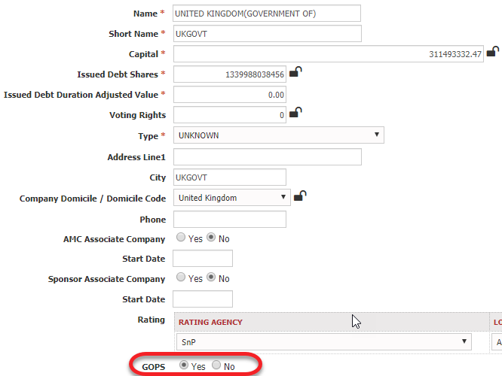
How can I clear this breach? (cont.)
  Another potential reason for this breach flagging is that instruments such as Government Bonds are not being excluded from the rule.
  If this the case, then it can be easily fixed by identifying the issuer for the bond and locating it in the Company Master.
  The ‘GOPS’ field need to be set as ‘Yes’ for any issuer that is a government or public body.
  Once the changes is made it will require a system approval from another user before it is made live.

Slide 9
How can I view this in a report?
  On FundWare, you can go to Reporting -> Holding Reports - > Holding Report and select one of a wide range of reports (e.g. Holding Export Report) to extract.
  You may wish to include the following columns:
  Rule Custom Attribute.Is Gops
  Rule Custom Attribute.Non EEA Market
  Instrument Exchange Short Name

Slide 10


