Slide 1

UCITS11 – Unlisted securities must be listed within one year

Slide 2
What does the rule monitor?
  UCITS11 monitors COLL 5.2.8 R (3)(e) and stipulates that unlisted securities must be listed within one year from the point of issue.

Slide 3
What fields does this rule monitor?
  This rule primarily uses 2 fields:
  ‘Days Since Listing’ which is a rule custom attribute.
  ‘Instrument Listed Type’ which is a rule custom attribute.
What asset type groups does it monitor?
  This rule is applied to assets that are Equities or Fixed Income.
Why might this rule be flagging as a breach?
  It’s possible it is flagging as a breach because the issue date has been incorrectly stipulated or perhaps the exchange code is not correctly populated.

Slide 4
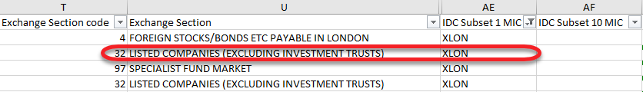
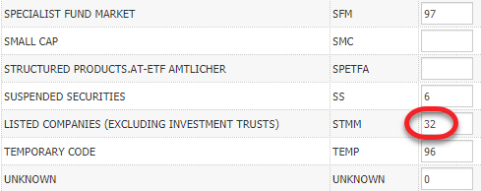
How can I clear this breach?
  If it is the case that exchanges are not populating then this will have to be updated. Ideally, this should be fixed using the Security setup file. Typically, for IDS security data, the “Exchange Section Code” value has to correctly correspond with the Market Section Code for the relevant exchange in the Exchanges Master.
  IDS Security File:
  For the above highlighted security, the exchange will only update if the “LISTED COMPANIES (EXCLUDING INVESTMENT TRUSTS)” market section in the Exchanges master for XLON is populated with the code of 32.
  Exchanges Master:

Slide 5
How can I clear this breach? (cont.)
  Alternatively, if it is an exceptional case then the exchange can be manually updated in the relevant instrument master. Once you’ve identified the security in the instrument master, scroll to the bottom of the page where you will find the ‘Exchanges’ section.
  Location the exchange code for the exchange you wish to update the security to be listed on. The sedol code needs to be added into the “Symbol Code” field and a market section must be selected in the drop-down menu.
  Once the change has been made you will need to add in a comment to the “Maker Comment” field and then send it for approval. The change will only go live once another user has approved it.

Slide 6

How can I clear this breach? (cont.)
  Verify that the listing date is correct for this security. You can find it in the instrument master for the security.
  In summary, if the security is exchange traded then it should not be picked up by this rule.
  Whether or not it is to be listed within the next 365 will be based on the “days since listing” calculation and whether it is between 0 and -365, noting that it will be negative where the listing date is in the future.
  Otherwise, it should pass.

Slide 7
How can I view this in a report?
  On FundWare, you can go to Reporting -> Holding Reports - > Holding Report and select one of a wide range of reports (e.g. Holding Export Report) to extract.
  You may wish to include the following columns:
  Days Since Listing
  Rule Custom Attribute.Days Since Listing
  Rule Custom Attribute.Instrument Listed Type
  Instrument Exchange Short Name

Slide 8


