Slide 1

UCITS15 – Max. 25% in units of any single CIS

Slide 2
What does the rule monitor?
  UCITS15 monitors COLL 5.2.29 R (3) and evaluates the number of units a fund has invested into a single collective investment scheme.
  Depending on the jurisdiction, the rule is applied at different levels. For UK funds, the rule is applied at Manager and Umbrella level as per COLL 5.2.30 R (1). For Irish/Lux funds, the rule is applied at Scheme level.

Slide 3
What fields does this rule monitor?
  This rule primarily uses 2 fields:
  Market Value in Scheme Currency
  Mutual Fund NAV
What asset type groups does it monitor?
  This rule is applied to assets that are Open Ended Funds.
Why might this rule be flagging as a breach?
  Data gaps. This breach often occurs if the Mutual Fund NAV field has not been populated with a value.
  Another possibility is that only a single share class is reflected in the NAV, as opposed to all of the share classes of that fund.

Slide 4
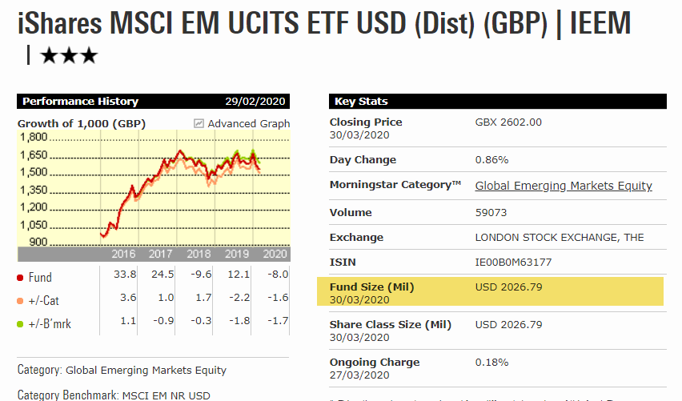
How can I clear this breach?
  Typically, the breach is caused by a missing Mutual Fund NAV value for the fund. You should first-of-all review the data in the FE_NAV file provided by Financial Express.
  There can be rare occasions whereby the fund size provided is not correctly reflected and we need to overwrite the data being uploaded through FE_NAV . We can do this by updating the override file with the new fund (FE_NAV_OV).
  You will need to research the fund size for the fund. You can do this using a variety of sources but MorningStar is perhaps the most common. A quick Google search of the ISIN should provide you with the link.
  When updating the FE_NAV_OV file you must ensure the value you are pasting in to the “FundSizeLocal” column is in the currency of the fund that is showing in the Fund Master on FundWare.
  If the fund’s currency is GBP but the MorningStar fund size is in USD then you will need to convert the MorningStar value to GBP. You can do this by finding the FX Rate and making the calculation.
  There is a centralised FE_NAV_OV file that must be updated before this upload can re-occur daily. A Data Management Analyst can make this update if they are provided with the ISIN and Fund Size.

Slide 5
How can I view this in a report?
  On FundWare, you can go to Reporting -> Holding Reports - > Holding Report and select one of a wide range of reports (e.g. Holding Export Report) to extract.
  You may wish to include the following columns:
  Mutual Fund NAV
  % of Mutual Fund NAV
  Please note that the Mutual Fund NAV column is in the local currency.

Slide 6


