Slide 1

UCITS18 – Max 35% in securities of any one GOPS Issuer, unless the issuer is a 100% GOPS issuer

Slide 2
What does the rule monitor?
  UCITS18 monitors COLL 5.2.12 R (2) and evaluates the percentage of the portfolio for each GOPS issuer. A breach will flag if any GOPS issuer has greater than 35% of the scheme NAV.
  However, there are exemptions to this. An authorised fund may invest up to 100% of the scheme property in GOPS issuers if it is stated in the prospectus, there are a minimum of 6 issues (UCITS20) and if no single issue is greater than 30% (UCITS19)

Slide 3
What fields does this rule monitor?
  This rule primarily uses the following fields:
  Exposure
  Exposure %
  Issuer Group
  Issuer is GOPS
  Scheme NAV
  However, please note that the ‘Issuer’ field may be used instead of ‘Issuer Group’. Similarly, ‘Market Value in Scheme Currency’ may be used instead of ‘Exposure’. Please review the Rules Configuration for your environment to clarify which is being used.
  The rule will also refer to the Scheme Mandate for the fund. Issuers assigned to Government and Public Securities section are permitted to have more than 35% investment.

Slide 4
What asset type groups does it monitor?
  This rule is applied to assets that are government and public securities.
Transferable Securities
Standard Transferable Securities
BP, RBS etc.
Government
Issuers
Covered
Bonds
35% any one issuer
Max 100% if:
In Prospectus
Max 30% any 1 issue
Minimum 6 issues
5 / 25 / 80 Rule
5 / 10 / 40 Rule
(i.e. UCITS 16 / 17)

Slide 5
Example Portfolio
  The maximum amount of the Scheme NAV that a single GOPS Issuer can have is 35%.
  Therefore, a portfolio can be made up of just 3 bonds as demonstrated below.
Holding | % NAV
Spain Gov’t Bond | 35%
Italian Gov’t Bond | 35%
French Gov’t Bond | 30%
Total | 100%
  Can increase to 100% in respect of a GOPS Issuer if it is specified in the Scheme’s Prospectus.
  Plus, it must have:
  * Max 30% in any one Issue (UCITS 19)
  * Minimum 6 different Issues (UCITS 20)

Slide 6
Why might this rule be flagging as a breach?
  The Scheme Mandate for the Scheme breaching may not be classifying specific Issuers as being permitted to have up to 100% investment.
  The Issuer for the security may be defined incorrectly.
  Equity Index Futures could be incorrectly marked as Government Bond Futures.
  The exposure for one or more Government Bond Futures could be overstated.

Slide 7
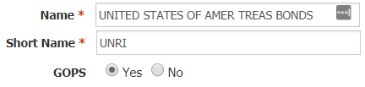
How can I clear this breach?
  First - you must establish why the breach is occurring.
  Company Review
  Using a holdings export report, verify that the issuer is consistent with the security description.
  No debt instrument should have an Issuer value of “UNKNOWN”. This will need to be corrected.
  If the security is a government bond (e.g. “USA TREASURY BDS 0.75% TIPS 15/02/2045 USD“) then ensure that the issuer field reflects the correct issuer (e.g. “UNITED STATES OF AMER TREAS BONDS”) and that it is a marked as a GOPS Issuer in the Company Master.
  Non-Government securities will have different restrictions applied (please see UCITS16 and UCITS17 for more information) and thus should not be included for the purposes of this rule.

Slide 8
How can I clear this breach? (cont.)
  Derivative Exposure Review
  Government Bond Futures may be factored into this rule and, thus, we must ensure the exposure calculated is correct.
  If there are Government Bond Futures causing this breach, then you will need to download a “Rule 28 – Derivatives Exposure Report” and review the derivative setup as per the daily governance checklist. First, you must review if every derivative has the correct underlying instrument assigned to it. E.g. we would expect a US 2 Year T-Note Future (TUM0) to have TU1 COMDTY as the underlying instrument.
  The below fields are used in the calculation of the commitment exposure of derivatives and, as such, each element needs to be correct for an accurate exposure calculation.
  No of Contracts * Derivative Market Lot * Underlying Market Price * Delta / UL FX Rate
  No of Contracts is uploaded through the client holdings file.
  Derivative Market Lot is specified in the derivative setup file
  Underlying Market Price is uploaded through the derivative price files (derivpf or derivpf_indices etc)
  Delta defaults to 1 upon initial setup but can be specified in the DerivGF file
  UL FX Rate is uploaded through the client FX Rates file.

Slide 9
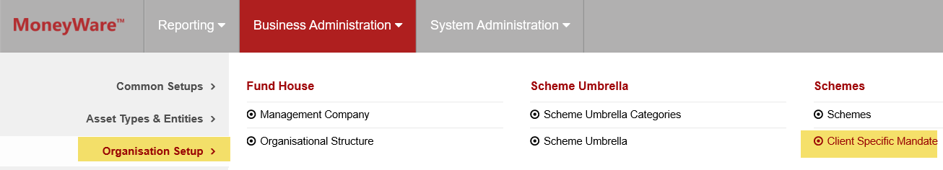
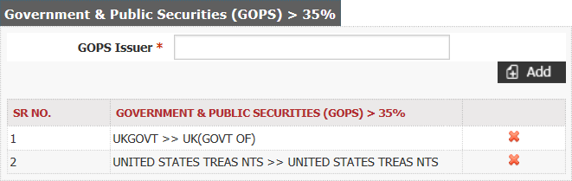
How can I clear this breach? (cont.)
  Scheme Mandate Review
  If the prospectus states that government issuers (e.g. UK Government, US Government) can have greater than 35% of the portfolio’s investment, then the Scheme Mandate needs to be updated to reflect this.
  To find the Scheme Mandate on FundWare go to Business Administration -> Organisation Setup -> Client Specific Mandate
  Ensure that all government issuers permitted to have greater than 35% of the portfolio’s investment are on the list under the “Government and Public Securities” section for the relevant Scheme. If an issuer is absent, then add the issuer name into the “GOPS Issuer” field and select the correct drop-down option that appears. Hit the ‘Add’ button to add it and then send for approval.

Slide 10
How can I validate this breach?
SEDOL | Security Name | Exposure | Exposure % | Scheme NAV | Issuer
BDXM6S3 | UK(GOVT OF) 0% T-BILL 01/04/19 GBP0.01 | 20,000,000.00 | 20.0000 | 100,000,000.00 | UK(GOVT OF)
BXRHNZ0 | UK(GOVT OF) 0% T-BILL 02/09/19 GBP0.01 | 10,000,000.00 | 10.0000 | 100,000,000.00 | UK(GOVT OF)
BDXL9H0 | UK(GOVT OF) 0% T-BILL 04/02/19 GBP0.01 | 7,000,000.00 | 7.0000 | 100,000,000.00 | UK(GOVT OF)
Total |  |  | 37.0000
  The above table provides adequate information in order to validate this rule. We know the above Treasury Bills have been issued by the UK Government. If the prospectus does not stipulate that the fund is permitted to have greater 35% investment in any one government issuer, then this would be a valid breach.
  If, however, the prospectus does stipulate this, then UCITS18 would not apply in this instance and instead UCITS19 and UCITS20 would be applied.

Slide 11
How can I view this in a report?
  On FundWare, you can go to Reporting -> Holding Reports - > Holding Report and select one of a wide range of reports (e.g. Holding Export Report) to extract.
  You may wish to include the following columns:
  Issuer Group
  Exposure
  Exposure %
  Issuer is GOPS

Slide 12


