Slide 1

UCITS20 – Minimum 6 issues, where issuer is a 100% GOPS issuer

Slide 2
What does the rule monitor?
  UCITS20 monitors COLL 5.2.12 R (3)(c) and evaluates the number of issues for a GOPS issuer, where that GOPS issuer is permitted to have up to 100% of the portfolio invested in it. A breach will occur if there are fewer than 6 issues.
  Note that the regulations are not clear on “issues” – this can be interpreted as 6 issues of the same GOPS issuer group, or 6 issues of any GOPS issuers.
  Where a GOPS is not permitted to have up to 100% of the portfolio invested in a single GOPS issuer, please see UCITS18 for more information.

Slide 3
What fields does this rule monitor?
  This rule primarily uses the following fields:
  Exposure
  Exposure %
  Issuer Group
  Issuer is GOPS
  Scheme NAV
  However, please note that the ‘Issuer’ field may be used instead of ‘Issuer Group’. Similarly, ‘Market Value in Scheme Currency’ may be used instead of ‘Exposure’. Please review the Rules Configuration for your environment to clarify which is being used.
  The rule will also refer to the Scheme Mandate for the fund. Issuers assigned to Government and Public Securities section are permitted to have more than 35% investment.

Slide 4
What asset type groups does it monitor?
  This rule is applied to assets that are government and public securities.
Transferable Securities
Standard Transferable Securities
BP, RBS etc.
Government
Issuers
Covered
Bonds
35% any one issuer
Max 100% if:
In Prospectus
Max 30% any 1 issue
Minimum 6 issues
5 / 25 / 80 Rule
5 / 10 / 40 Rule
(i.e. UCITS 16 / 17)

Slide 5
Example Portfolio
  If the portfolio’s prospectus states that it can have up to 100% invested in a GOPS Issuer, then each issue can have no more than 30% of the scheme NAV in value (UCITS19).
  Additionally, it must have a minimum of 6 different issues. Fewer than this amount would result in a breach. Note the earlier comments about issues of the same GOPS issuer versus issues of any GOPS issuer. Clients may elect to have either version applied.
Holding | % NAV
Spain Gov’t 1Yr | 30%
Spain Gov’t 5Yr Bond | 30%
Spain Gov’t 10Yr Bond | 30%
Spain Gov’t 15Yr Bond | 9%
Spain Gov’t Long Bond | 0.9%
Spain Gov’t Perpetual Bond | 0.1%
Total | 100%

Slide 6
Why might this rule be flagging as a breach?
  The Issuer for the security may be defined incorrectly.
  Equity Index Futures could be incorrectly marked as Government Bond Futures.
  Holdings invalids that are new securities to be requested will not be included in the count.
  Clients may have the version of the rule set to look only at issues of that 100% GOPS issuer rather than any GOPS issuer

Slide 7
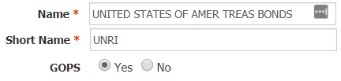
How can I clear this breach?
  First - you must establish why the breach is occurring.
  Company Review
  Using a holdings export report, verify that the issuer is consistent with the security description.
  No debt instrument should have an Issuer value of “UNKNOWN”. This will need to be corrected.
  If the security is a government bond (e.g. “USA TREASURY BDS 0.75% TIPS 15/02/2045 USD“) then ensure that the issuer field reflects the correct issuer (e.g. “UNITED STATES OF AMER TREAS BONDS”) and that it is a marked as a GOPS Issuer in the Company Master.
  Non-Government securities will have different restrictions applied (please see UCITS16 and UCITS17 for more information) and thus should not be included for the purposes of this rule.

Slide 8
How can I clear this breach? (cont.)
  Derivative Exposure Review
  Government Bond Futures may be factored into this rule and, thus, we must ensure the exposure calculated is correct.
  If there are Government Bond Futures causing this breach, then you will need to download a “Rule 28 – Derivatives Exposure Report” and review the derivative setup as per the daily governance checklist. First, you must review if every derivative has the correct underlying instrument assigned to it. E.g. we would expect a US 2 Year T-Note Future (TUM0) to have TU1 COMDTY as the underlying instrument.
  The below fields are used in the calculation of the commitment exposure of derivatives and, as such, each element needs to be correct for an accurate exposure calculation.
  No of Contracts * Derivative Market Lot * Underlying Market Price * Delta / UL FX Rate
  No of Contracts is uploaded through the client holdings file.
  Derivative Market Lot is specified in the derivative setup file
  Underlying Market Price is uploaded through the derivative price files (derivpf or derivpf_indices etc)
  Delta defaults to 1 upon initial setup but can be specified in the DerivGF file
  UL FX Rate is uploaded through the client FX Rates file.

Slide 9
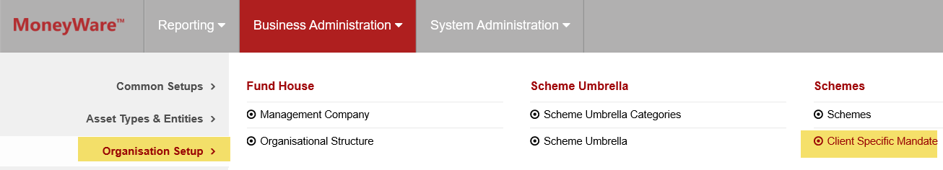
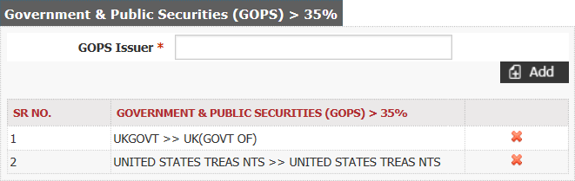
How can I clear this breach? (cont.)
  Scheme Mandate Review
  If the prospectus states that government issuers (e.g. UK Government, US Government) can have greater than 35% of the portfolio’s investment then the Scheme Mandate needs to be updated to reflect this.
  To find the Scheme Mandate on FundWare go to Business Administration -> Organisation Setup -> Client Specific Mandate
  Ensure that all government issuers permitted to have greater than 35% of the portfolio’s investment are on the list under the “Government and Public Securities” section for the relevant Scheme. If an issuer is absent, then add the issuer name into the “GOPS Issuer” field and select the correct drop-down option that appears. Hit the ‘Add’ button to add it and then send for approval.

Slide 10
How can I clear this breach? (cont.)
  Rule review
  Confirm the rule application with the client. It may be that the version of the rule applied considers only 6 issues of that 100% GOPS issuer, rather than 6 issues of any GOPS issuer. If the client confirms that they wish the 6 issues of any GOPS issuer rule applied, remove the version applied in favour of the “any GOPS issuer” version.

Slide 11
How can I validate this breach?
  Rule Validation Example:
SEDOL | Security Name | Exposure | Exposure % | Scheme NAV | Issuer | #
BDXM6S3 | UK(GOVT OF) 0% T-BILL 01/04/19 GBP0.01 | 30,000,000.00 | 30 | 100,000,000.00 | UK(GOVT OF) | 1
BXRHNZ0 | UK(GOVT OF) 0% T-BILL 02/09/19 GBP0.01 | 24,000,000.00 | 24 | 100,000,000.00 | UK(GOVT OF) | 2
BDXL9H0 | UK(GOVT OF) 0% T-BILL 04/02/19 GBP0.01 | 18,000,000.00 | 18 | 100,000,000.00 | UK(GOVT OF) | 3
BDXND52 | UK(GOVT OF) 0% T-BILL 16/09/19 GBP0.01 | 16,000,000.00 | 16 | 100,000,000.00 | UK(GOVT OF) | 4
BHLCFB9 | UK(GOVT OF) 0% T-BILL 16/03/2020 GBP | 12,000,000.00 | 12 | 100,000,000.00 | UK(GOVT OF) | 5
Total |  |  | 100
  The above table provides adequate information in order to validate this rule. We know the above Treasury Bills have been issued by the UK Government and if we assume the prospectus stipulates that up to 100% of the scheme NAV can be invested in the UK Government, then this would be a valid breach as there are only 5 issues.
  To pass, it must have a minimum of 6 issues. For the alternative version of the rule, which applies to 6 issues of any GOPS issuer, you could consider any other GOPS issued securities.
  Always check the Holdings file invalids as there could be a new security issue that just needs to be requested from the data vendor (e.g. ICE Data Services). This would not be factored into the FundWare results and could result in an erroneous breach.

Slide 12
How can I view this in a report?
  On FundWare, you can go to Reporting -> Holding Reports - > Holding Report and select one of a wide range of reports (e.g. Holding Export Report) to extract.
  You may wish to include the following columns:
  Issuer Group
  Exposure
  Exposure %
  Issuer is GOPS

Slide 13


