Slide 1

UCITS21 – Max. 25% in Covered Bonds

Slide 2
What does the rule monitor?
  UCITS21 monitors COLL 5.2.11 R (5A) and evaluates the percentage of the portfolio for each issuer of covered bonds. A breach will occur if more then 25% of the portfolio is in any single issuer of covered bonds.
  This rule only applies to bonds issued by a credit institution with special public supervision.

Slide 3
What asset type groups does it monitor?
  This rule is applied to assets that are Covered Bonds.
Transferable Securities
Standard Transferable Securities
BP, RBS etc.
Government
Issuers
Covered
Bonds
35% any one issuer
Max 100% if:
In Prospectus
Max 30% any 1 issue
Minimum 6 issues
5 / 25 / 80 Rule
5 / 10 / 40 Rule
(i.e. UCITS 16 / 17)

Slide 4
What fields does this rule monitor?
  This rule primarily uses the following fields:
  Exposure
  Exposure %
  Issuer
  Scheme NAV
  Rule Custom Attribute.Covered Bonds
  List.Covered Bonds
Why might this rule be flagging as a breach?
  The Issuer for the security may be defined incorrectly.
  The security may be incorrectly defined on the Covered Bonds black/white list.

Slide 5
How can I clear this breach?
  First - you must establish why the breach is occurring.
  Company Review
  Using a holdings export report, verify that the issuer is consistent with the security description.
  No debt instrument should have an Issuer value of “UNKNOWN”. This will need to be corrected.
  Before updating a security's company field, you must ensure the correct issuer is already set up in the Company Master. Following this you can then amend the “Company” field in the relevant instrument master for the security.

Slide 6
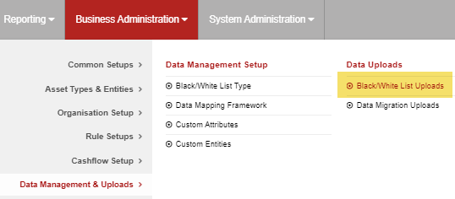
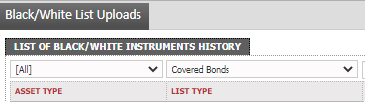
How can I clear this breach? (cont.)
  Black/White List Review
  Go to Business Administration -> Data Management & Uploads -> Black/White List Uploads
  Set the List Type to be “Covered Bonds” and click the “Search” button to filter for these.
  If it is not a Covered Bond, you will need to delete the entry and get an approval.

Slide 7
How can I validate this breach?
SEDOL | Security Name | Exposure | Exposure % | Scheme NAV | Issuer
ABC123 | Covered Bond 1 | 12,000,000 | 12.0000 | 100,000,000 | XYZ Holdings
DEF456 | Covered Bond 2 | 10,000,000 | 10.0000 | 100,000,000. | XYZ Holdings
GHI789 | Covered Bond 3 | 5,000,000 | 5.0000 | 100,000,000 | XYZ Holdings
Total |  |  | 27.0000
  The above table provides adequate information in order to validate this rule. We know the above Covered Bonds have been issued by the same issuer and as the aggregated value is greater than 25%, it is then a breach.

Slide 8
How can I view this in a report?
  On FundWare, you can go to Reporting -> Holding Reports - > Holding Report and select one of a wide range of reports (e.g. Holding Export Report) to extract.
  You may wish to include the following columns:
  Issuer
  Exposure
  Exposure %
  List.Covered Bonds

Slide 9


