Slide 1

UCITS22 - Max 80% in Bonds of Credit Institutions with Special Public Supervision in more than 5%

Slide 2

What does the rule monitor?
  UCITS22 monitors COLL 5.2.11 R (5a) and it stipulates that when a UCITS funds invests more than 5% in covered bonds issued by a single body, the total value of covered bonds must not exceed 80% in value of the Scheme NAV.

Slide 3
What asset type groups does it monitor?
  This rule is applied to assets that are Covered Bonds.
Transferable Securities
Standard Transferable Securities
BP, RBS etc.
Government
Issuers
Covered
Bonds
35% any one issuer
Max 100% if:
In Prospectus
Max 30% any 1 issue
Minimum 6 issues
5 / 25 / 80 Rule
5 / 10 / 40 Rule
(i.e. UCITS 16 / 17)

Slide 4
What fields does this rule monitor?
  This rule primarily uses the following fields:
  Exposure
  Exposure %
  Scheme NAV
  Issuer
  Underlying Issuer
  Rule Custom Attribute.Covered Bonds
  List.Covered Bonds
Why might this rule be flagging as a breach?
  The Issuer for the security may be defined incorrectly.
  The security may be incorrectly defined on the Covered Bonds black/white list.

Slide 5
How can I clear this breach?
  First - you must establish why the breach is occurring.
  Company Review
  Using a holdings export report, verify that the issuer is consistent with the security description.
  No debt instrument should have an Issuer value of “UNKNOWN”. This will need to be corrected.
  Before updating a security's company field, you must ensure the correct issuer is already set up in the Company Master. Following this you can then amend the “Company” field in the relevant instrument master for the security.

Slide 6
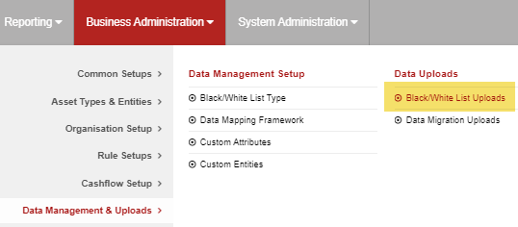
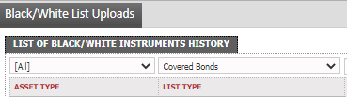
How can I clear this breach? (cont.)
  Black/White List Review
  Go to Business Administration -> Data Management & Uploads -> Black/White List Uploads
  Set the List Type to be “Covered Bonds” and click the “Search” button to filter for these.
  If it is not a Covered Bond you will need to delete the entry and get an approval.

Slide 7
How can I validate this breach?
SEDOL | Security Name | Exposure | Exposure % | Scheme NAV | Issuer
ABC123 | Covered Bond 1 | 22,000,000 | 22 | 100,000,000 | ABC Holdings
DEF456 | Covered Bond 2 | 20,000,000 | 20 | 100,000,000 | DEF Holdings
GHI789 | Covered Bond 3 | 15,000,000 | 15 | 100,000,000 | GHI Holdings
JKL123 | Covered Bond 4 | 10,000,000 | 10 | 100,000,000 | JKL Holdings
MNO456 | Covered Bond 5 | 9,000,000 | 9 | 100,000,000 | MNO Holdings
PQR789 | Covered Bond 6 | 6,000,000 | 6 | 100,000,000 | PQR Holdings
TOTAL |  |  | 82
  The above table provides adequate information in order to validate this rule. We know the above Covered Bonds are aggregated at Issuer level and each greater than 5% of the Scheme NAV. As the aggregated Exposure % is greater than 80% it is therefore a breach.

Slide 8
How can I view this in a report?
  On FundWare, you can go to Reporting -> Holding Reports - > Holding Report and select one of a wide range of reports (e.g. Holding Export Report) to extract.
  You may wish to include the following columns:
  Issuer
  Exposure
  Exposure %
  List.Covered Bonds

Slide 9


