Slide 1

UCITS28 – Max 200% Total Global Exposure (incl. 100% FDI)

Slide 2
What does the rule monitor?
  UCITS28 monitors COLL 5.3.3A. For any UCITS scheme, the exposure arising from derivatives must be LESS than 100% of the NAV. Our interpretation is therefore that:
  The exposure must be LESS than 200% of the NAV
  i.e. 100% direct*+ 100% indirect exposure from derivatives
  * 100% direct meaning all bonds, equities and funds etc. which do not give incremental leverage but their exposure is equal to their market value

Slide 3
What fields does this rule monitor?
  This rule looks primarily at the following fields:
  Exposure
  Holdings NAV
  Correct MVBase
What asset type groups does the rule monitor?
  The rule is applied to all assets.
Why might this rule be flagging as a breach?
  Derivative assets may be set up incorrectly causing an erroneous spike in exposure.
  Derivative Underlying prices may not be correct.
  Derivative assets may not be netting correctly.
  There may be an FX rollover causing the exposure from Forwards to spike temporarily.
  Some derivative asset types may need to be classified as risk-free in certain instances (e.g. scheme currency FFX)
  Not all asset types may be captured by the “All Assets” asset category.

Slide 4
How can I clear this breach?
  First you must understand why this breach is occurring. There are a few reports that are helpful, but often a good place to start is by downloading a Detailed Commitment Exposure Report (please see last slide for details on where to find this report). Then you can review the incremental leverage column for any anomalies.
  Long equities, bonds and funds have no risk beyond their investment and so have no additional exposure (or “leverage”) beyond their market value. Therefore, for these types of assets, market value = exposure.
  Derivative exposure, on the other hand, is calculated using a different method.
  Review Derivative Setup
  Download a ‘Rule 28 Derivatives Exposure Report’ in the Holding Reports section of FundWare, and filter for the relevant fund to review the derivative setups.
  There are 5 fields which contribute to the exposure value of a derivative. The calculation is as follows:
  Derivative Exposure = (Quantity * Multiplier * Underlying Market Price * Delta) / Underlying FX Rate
  Incremental leverage is calculated as follows:
  Incremental Leverage = (Absolute Exposure – Correct MVBase) / Holdings NAV

Slide 5
How can I clear this breach?
  These factors that contribute to the derivative exposure calculation come from various data sources:
  Quantity – Client Holdings file
  Multiplier (aka Derivative Market Lot) – Derivative setup file
  Underlying Market Price – derivative price file (e.g. DerivPF, DerivPF_indices, DerivPF_CFD etc.)
  Delta – DerivGF file
  Underlying FX Rate – Currency rates file
  Each of these factors must be correct in order for the exposure calculation to be correct. Please consult the Derivative Setup Checklist document when reviewing the setup.
  Common issues:
  Options require a delta figure. Without one the exposure can spike.
  The Multiplier is incorrect.
  The Underlying Market Price is incorrect.

Slide 6
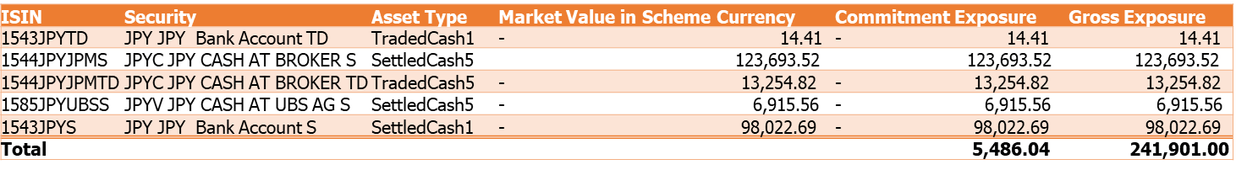
Netting
  Netting is when a position in one security or currency is aggregated with other positions in the same or similar securities/currencies. The general goal of netting is to offset losses in position with gains in another.
  Some types of Exposure, such as commitment exposure, require the netting of long and short positions before the exposure can be calculated.
  Example:
  As you can see from the below table there is a large difference between the gross exposure of these cash lines compared to when the long and short positions are netted for commitment exposure.
  These cash lines can be netted together because they are all JPY cash positions that share the same UL ID value. Instruments will only net if they have the same UL ID value.

Slide 7
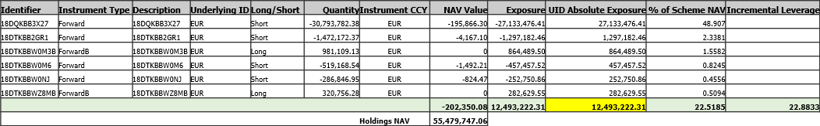
Hedging
  One way to understand hedging is to think of it as insurance. When investment managers decide to hedge, they are essentially insuring themselves against a negative event. This does not prevent the negative event from happening but what it does do is reduce the impact of this event.
  There are different ways to hedge risk but perhaps the most common is through the use of currency forwards.
  If hedging was not accounted for, you would likely have an exaggerated exposure value. As you can see from the below table, the absolute exposure value used in the leverage calculation is 12.49M and not the exposure total for the Forwards (~30M).
  So, how is this 12.49M figure actually calculated?

Slide 8
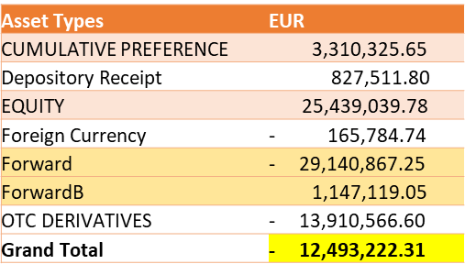
Hedging
  To understand where this figure is coming from you can run a Currency Exposure Report on FundWare for a specific fund and date. (Holding Report -> Currency Exposure Report).
  The below table is an excerpt showing the breakdown of the EUR currency on a scheme. As you can see, the approx. -28M in exposure from the Forwards is overhedging the rest of the EUR Holdings on this portfolio (15.5M) to produce a total of -12.49M. This value is then used as the exposure value instead of the EUR Forwards exposure total.
  By using the -12.49M figure, it produces an incremental leverage result of 22.8833%. If hedging was not applied the result would instead be 50.8223%.

Slide 9
Risk-Free Assets
  Depending on the type of exposure, there may also be risk-free assets. Risk free assets may have the effect of deleveraging the fund (reducing exposure).
  Risk-free assets have an exposure of 0. However, they can have a positive or negative incremental leverage.
  If the NAV value for a risk-free asset is positive, leverage from the asset will be negative.
  If the NAV value for a risk-free asset is negative, leverage from the asset will be positive.
  Example risk-free assets:
  Treasury Bills within 3 months to maturity
  Cash and deposits which are base currency
  Forwards in base currency
  Pending items in base currency
  Both CP Proxy and CP proxy offset asset types should be risk free (these will offset to give 0 incremental leverage in total)

Slide 10
How can I validate this breach?
  The best way to view a breakdown of a fund’s global exposure is to view a detailed commitment exposure report for that scheme.
  It can be difficult showing the result of this breach in a holdings export report as it does not easily display the impact of changes from netting or hedging. However, the most common reason for the occurrence of this breach is the incorrect setup of derivatives.

Slide 11
How can I view this in a report?
  On FundWare, you can go to Reporting -> Risk Reporting - > Portfolio Exposures and run a report to view the detailed commitment exposure report.

Slide 12


