Slide 1

UCITS31 – No Physical Short Selling

Slide 2
What does the rule monitor?
  UCITS31 monitors COLL 5.2.22 R. It will flag as a breach if there is any short selling of securities.
  No agreement by or on behalf of a UCITS scheme to dispose of property or rights may be made unless:
  the obligation to make the disposal and any other similar obligation could immediately be honoured by the UCITS scheme by delivery of property or the assignment of rights; and
  the property and rights at (a) are owned by the UCITS scheme at the time of the agreement.

Slide 3
What fields does this rule monitor?
  This rule looks primarily at the following fields:
  Quantity
  Rule Custom Attribute.UCITS Asset Type
What asset type groups does the rule monitor?
  The rule will monitor all equities, funds, debts and structured products. It will not include derivatives or cash or equivalent instruments.
Why might this rule be flagging as a breach?
  The asset may not be correctly classified.

Slide 4
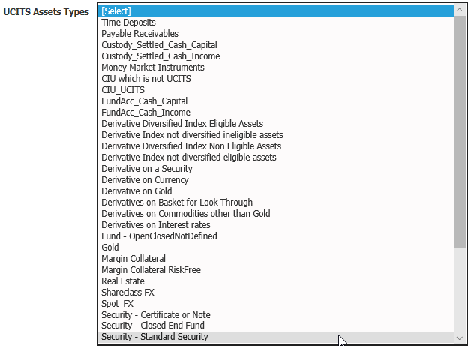
How can I clear this breach?
  First, we must establish how the instrument is being classified. Download a Holdings Export report and include the column called “Rule Custom Attribute.UCITS Asset Types” and review whether it is being correctly classified.
  If it is not being classified correctly, then go onto FundWare and locate the instrument in the relevant instrument master. In the drop-down menu for “UCITS Asset Types”, select the appropriate option and send it for approval.

Slide 5
How can I validate this breach?
  Rule Validation Example:
  The above table provides adequate information in order to validate this rule.
  As the instrument is an equity and the quantity is short 10,000 then it is correct that this rule is breaching.
Insturment Security Code | Security Name | Quantity | Asset Type | Rule Custom Attribute.UCITS Asset Types
2000019 | AMAZON COM INC COM USD0.01 | - 10,000 | EQUITY | Security - Standard Security

Slide 6
How can I view this in a report?
  On FundWare, you can go to Reporting -> Holding Reports - > Holding Report and select one of a wide range of reports (e.g. Holding Export Report) to extract.

Slide 7


