Slide 1

UCITS37 – No Persistent Borrowing

Slide 2
What does the rule monitor?
  UCITS37 monitors COLL 5.5.4 R (4) and COLL 5.5.4 R (5).
  The authorised fund manager must ensure that any borrowing is on a temporary basis and that borrowings are not persistent, and for this purpose the authorised fund manager must have regard in particular to:
    the duration of any period of borrowing; and
    the number of occasions on which resort is had to borrowing in any period.
  In addition to complying with the above, the authorised fund manager must ensure that no period of borrowing exceeds three months, whether in respect of any specific sum or at all, without prior consent of the depositary.

Slide 3
FundWare Interpretation
  As the monitoring of any borrowings is left to the Manager’s discretion, FundWare can tailor the set-up of the persistent borrowing rules to be line with the Manager’s interpretation of what constitutes persistent borrowing.
  There are 2 main areas for the rule set-up:
    Level of netting – Fund Level, Instrument Level, Currency Level
    Period under consideration – continuous, non-continuous and number of days.
  As a default, FundWare will monitor borrowing at an instrument level and if there is continuous borrowing in any currency for a period of 90 days then a breach will flag (please see UCITS37b).
  However, in addition to this, FundWare will take the prudent approach and monitor at different levels of netting and with various periods under consideration.
  UCITS37a – Continuous for 90 days, fund level netting
  UCITS37b – Continuous for 90 days, no netting
  UCITS37c – If any for 127 days out of previous 180 days, fund level netting
  UCITS37d – If any for 163 days out of previous 270 days, fund level netting
  UCITS37e – If any for 181 days out of previous 360 days, fund level netting

Slide 4
What fields does this rule monitor?
  This rule looks primarily at the following fields:
  Asset Type
  Market Value in Scheme Currency
  Instrument Currency Symbol
What asset type groups does the rule monitor?
  The rules monitors cash.
Why might this rule be flagging as a breach?
  The level of netting is overly prudent for what is required by the Depositary.
  The rule may be picking up more asset types than it should. If multiples types of cash are uploaded (e.g. fund accounting, custody) then it should only pick up custody cash. No offset lines should be factored into this rule.
  The Cash data source may be from fund accounting reporting rather than custody reporting.
  The Depositary has consented to the period of persistent borrowing.

Slide 5
How can I clear this breach?
  Level of Netting
  Establish at which level of netting the breach is occurring. It is most likely that a UCITS37b (no netting) breach has occurred which is the most prudent version of the persistent borrowing rules.
  Using the Persistent Borrowing report on FundWare, compile analysis to understand what the rule result would be if netting did occur at either Currency or Fund level.
  Discuss this with the client to establish what the most appropriate level of monitoring would be for persistent borrowing on their funds. If any changes need to be made, please raise this with the Internal Projects Support team.
  Asset Types
  Review the rule setup in the Rules Configuration section of FundWare to understand which asset types the rule will consider. If the rule is picking up more than is appropriate, then please raise this with Internal Projects Support to investigate further.
  It is likely that the rule will just need to be amended to look only at the appropriate asset types.
  If multiples types of cash are uploaded (e.g. fund accounting, custody) then the rule should only pick up custody cash. No offset lines should be considered into this rule.

Slide 6
How can I view this in a report?
  On FundWare, you can go to Reporting -> Holding Reports - > Borrowing Report
  Scroll to the bottom of the report wizard and set the report type to be “Funds Detailed Borrowing – Time Series.
  At the top of the page set your date range.

Slide 7
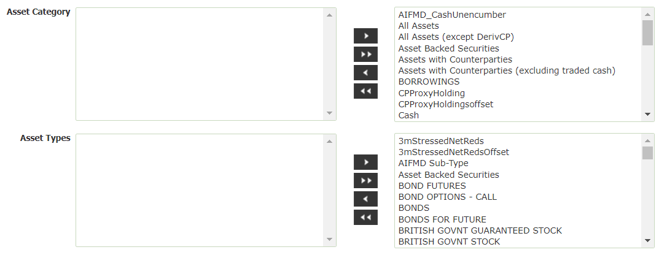
How can I view this in a report?
  There are defaults set for Asset Category and Asset Type which doesn’t always correspond with UCITS37. Move all categories and type to the right hand side.
  You can then filter on the specific asset types required in the Excel export and exclude irrelevant asset types.
  You may also wish to select a specific Scheme to run the report against as opposed to all funds.

Slide 8
How can I validate this breach?
  Please see the “UCITS37 – Persistent Borrowing Example” Excel for a breakdown of how to validate a UCITS37a or UCITS37b breach.
  UCITS37a nets the cash at scheme level and will breach if it been overdrawn for 90 consecutive days.
  UCITS37b does not net any level and instead monitors each individual cash account. It will breach if any account has been overdrawn for 90 consecutive days.
  Additionally, an example of how to monitor at currency level has been included in the Excel example. If any individual currency has been overdrawn for 90 consecutive days a breach will occur.

Slide 9


